Slide 1
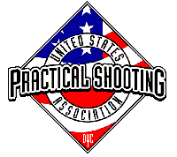
Bay 5, Stage 6 Duck Duck Goose Course Designer: Jordan Rogers
Duck Duck goose is a 23 round, 115 point Comstock long course. There are 11 USPSA targets and one steel target. The best two hits per target will score. Steel must fall to score. The start signal is audible.
The start position is anywhere completely within the shooting area. UNLOADED firearm lying flat and unsupported on table. The first ammunition loading device to be used during the course of fire must be on the table prior to the start signal.
On the audible start signal, engage targets as visible from within the shooting area. The walls DO NOT extend to infinity, targets may be engaged from beneath them. All barrels are soft cover.

Slide 2
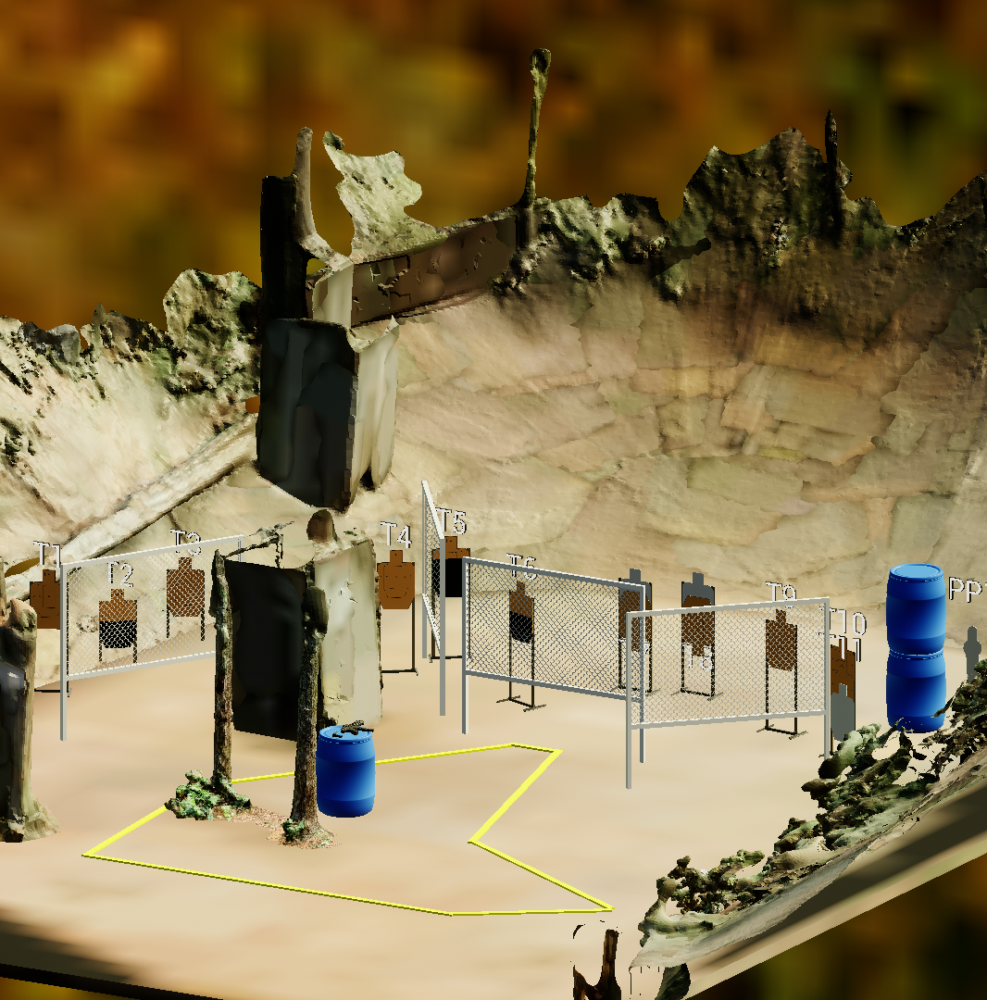
 | Stage 6 Duck Duck Goose Course Designer: Jordan Rogers

